Slide 1
Login Bypass

Slide 2
Types of Password Attacks
Passive online attacks
Active online attack
Offline attacks
Non-electronic attacks
Password Attack
Monitor or record data.
Wire Sniffing
Track data
Gain unauthorized administrator-level access to the system
Password guessing
Trojan/spyware/keyloggers
Hash injection
Phishing
Checks the validity of the passwords
Pre-computed hashes
Distributed Network
Rainbow
Non-technical attacks
Social engineering
Shoulder surfing
Dumpster Diving

Slide 3
OS Login Bypass
Password Protected Systems
Nowadays everyone use OS login on there Machine.
It checks in the database that is stored in file where all the passwords are stored.
It compares and accordingly open the system

Slide 4
Types Of Passwords
1. Power On Password
Authentication used before booting up the system and starts on when we press the power button.
2. BIOS / Supervisor Password
BIOS authentication occurs when we boot up our operating system and before our OS is ready.
3. OS Passwords
Mostly used and cracked by the attackers.
Types of Passwords

Slide 5
Which file in Windows stores the password of all the users??

Slide 6
SAM
In windows, SAM (Security Account Manager) file stores passwords of all the users of the system.
SAM is part of the registry and can be found on the hard disk.
C:\Windows\System32\config\SAM (contains password) encrypt NTLM & LM Hash
The samcli.dll (SAM client) file is part of the Microsoft Windows Operating System product
It’s Location/path in PC
C:\Windows\System32\samcli.dll (password are stored in encrypted form)
No body can delete this file

Slide 7
Which file in Linux/MAC are used for storing passwords?

Slide 8
etc
/etc/ is where configuration files and directories are located.
/etc/passwd-
The user database, with fields giving the username, real name, home directory, and other information about each user.
The format is documented in the passwd manual page.
/etc/shadow-
It is an encrypted file that holds user passwords.

Slide 9
Linus/Window/MAC
In windows-
Passwords can break
In Linux and MAC- passwords can be bypassed.
We can enter the system and can change the password.

Slide 10
OS Login BYPASS
Online Method
Offline Method
System locked
Login Bypass
System Unlocked

Slide 11
1.Online Method for Bypassing
If I get a call, or I go to washroom, or I go to take coffee-I keep my system unlocked → online
I need to overcome the original password.
These steps will tell you on the basis of scenario's that how to enter and crack into a particular operating system.

Slide 12

1. Online Bypass-Steps (not good Method)
My Computer > Right Click > Manage
Manage has local users and groups
Local Group and Users > Right Click > Create New User
Users folder show number of users
Enter entities of new user (Password is not required)
This creates a new user who is admin now u can do anything
C:\Users will also show all the users
Control panel-users accounts- also show all the users –can add users

Slide 13
1. Online Bypass-Steps (Good Method) using CMD
1. Open CMD (run as administrator)
2. CMD > net user (Net user is a tool which shows all the users)
3. CMD > net user username *
Eg cmd> net user Mehak *
Is used to change password
It will ask to enter and retype password.
4. Restart
Now do anything, you have your account in someone else system

Slide 14
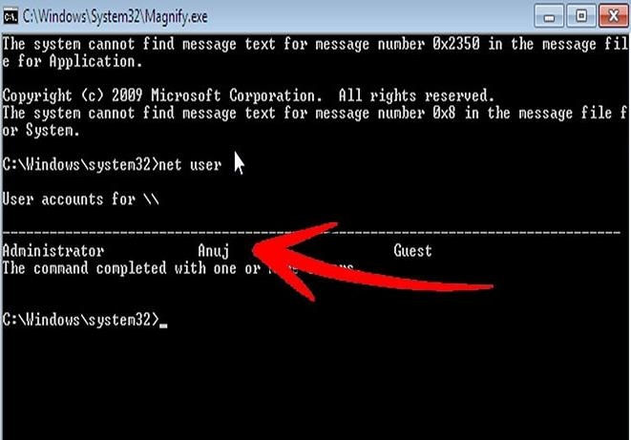
Write command net user
Open cmd
Command : Net user

Slide 15
Online Bypass:
Write command : net user username *
If user name has spaces : net user “Mehak Khurana” *
It will ask new password:

Slide 16
Online Bypass-Steps (add user)
Other commands
https://www.lifewire.com/net-user-command-2618097
You can also add user using /add
Open CMD (run as administrator)
CMD > net user username * /add
Eg cmd> net user Sharad * /add
It will ask to enter and retype password.

Slide 17
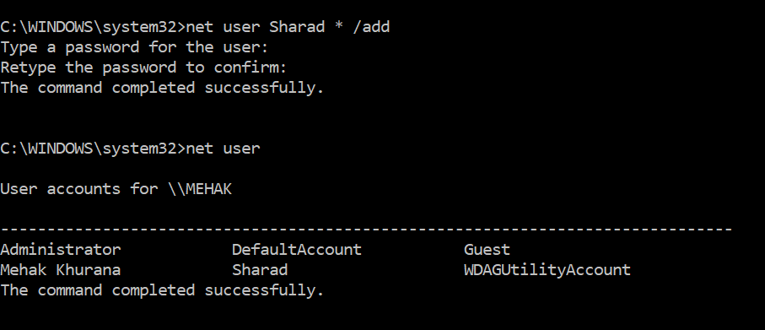
Online Bypass-Steps (add user)

Slide 18
In class Exercise
Use online method to add user and delete user
Perform all other commands of net user
Net user commands
Add new user change its password
Remove/delete new user
My Computer-manage
Add new user
Delete user

Slide 19
Password cracking tools
Password cracking tools
John the Ripper
Uses the command prompt to crack passwords.
https://www.openwall.com/john/
Cain & Abel
Used to recover passwords for user accounts, recovery of Microsoft Access passwords; networking sniffing, etc.
http://www.softpedia.com/get/Security/Decrypting-Decoding/Cain-and-Abel.shtml

Slide 20
Password cracking tool: Cain and Abel
Use NTLM in Cain and Abel
Cain and Abel cracker can be used to crack passwords using;
Dictionary attack
Brute force
Cryptanalysis
Use the dictionary attack in this example.
Download the dictionary attack wordlist from google:
Or here 10k-Most-Common.zip

Slide 21
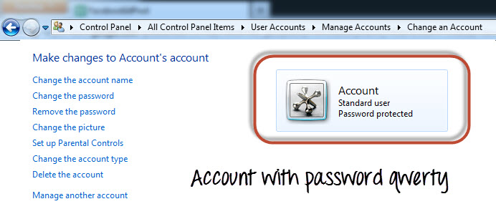
Password cracking tool: Cain and Abel
Create an account called Accounts with the password qwerty on Windows 7

Slide 22
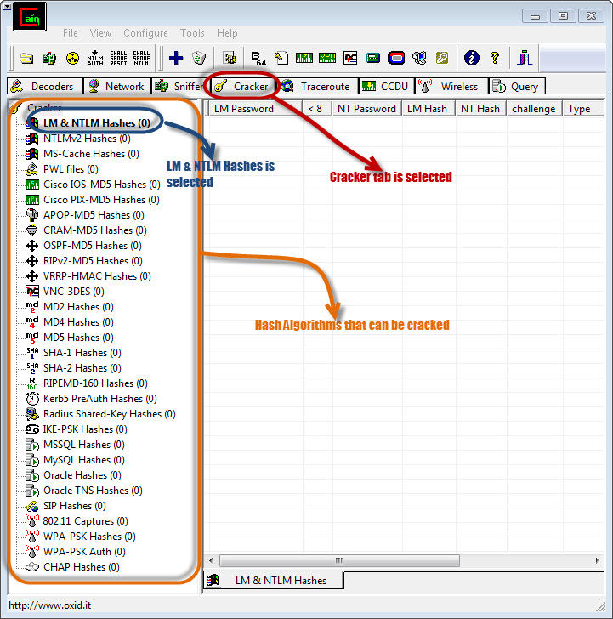
Password cracking steps
Open Cain and Abel, you will get the following main screen

Slide 23
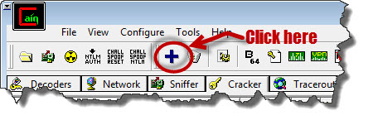
Password cracking steps
Make sure the cracker tab is selected as shown above
Click on the Add button on the toolbar.

Slide 24
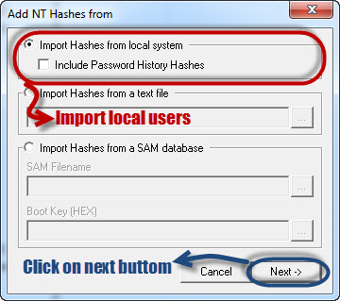
Password cracking steps
The following dialog window will appear

Slide 25
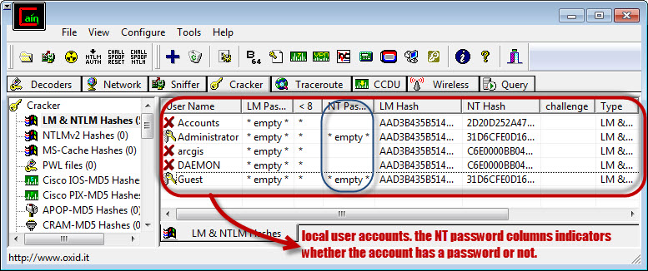
Password cracking steps
The local user accounts will be displayed as follows.
Note the results shown will be of the user accounts on your local machine

Slide 26
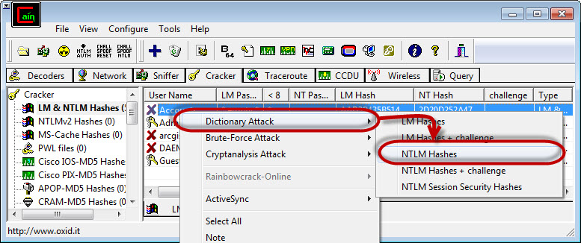
Password cracking steps
Right click on the account you want to crack.
Here We will use Accounts as the user account.

Slide 27
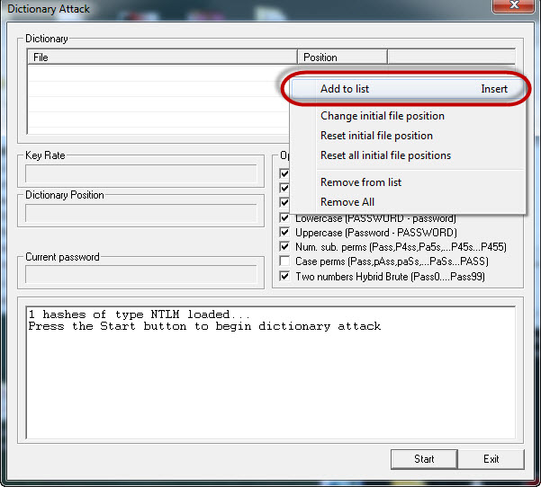
Password cracking steps
The following screen will appear

Slide 28
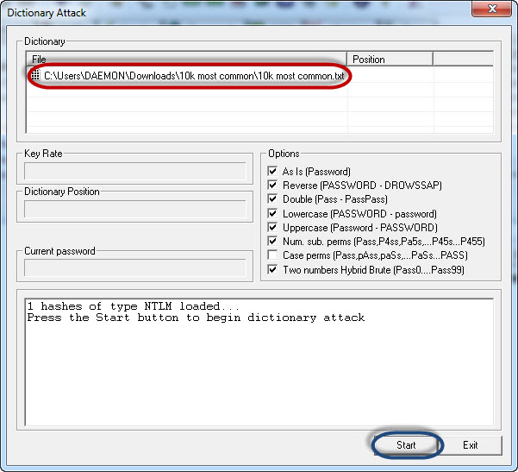
Password cracking steps
Right click on the dictionary section and select Add to list menu as shown above
Browse to the 10k most common.txt file that you just downloaded

Slide 29
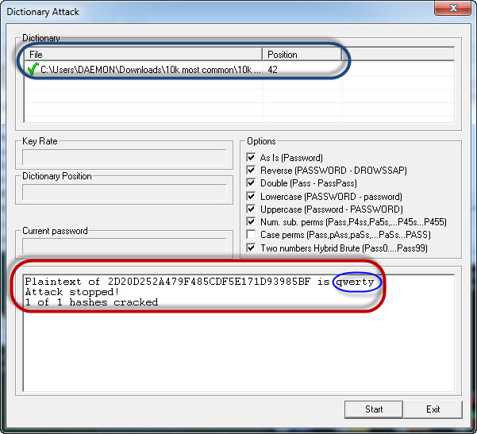
Password cracking steps
Click on start button
If the user used a simple password like qwerty, then you should be able to get the following results
Note: the time taken to crack the password depends on the password strength, complexity and processing power of your machine.
If the password is not cracked using a dictionary attack, you can try brute force or cryptanalysis attacks
.

Slide 30
2. Offline Bypass
Here Victim is already locked and we don't know the password.
How will you login
What can be Done??

Slide 31
2. Offline Bypass
Delete password files
Anti LM and Anti NTLM- it deletes the password files (search)
BIOS-Hiren screen-deletes file
Alternative For Offline Method: BIOS LOCK –
But it can be cracked by removing the BIOS Chip or
with tool OPHcrack.
Tools
Kon Boot
Active password changer (website-password-changer.com)etc
Hiren Boot (search)
Is a cross-platform that uses rainbow tables to crack passwords.
It runs on Windows, Linux and Mac OS. https://ophcrack.sourceforge.io/download.php
Live Operating Systems
Normally OS loads from internal storage which is located inside your Machine only.
Live Operating Systems are those which are installed or are placed in some kind of external storage like cd, dvd, usb etc.

Slide 32
Ophcrack- Class Task-1hr
With Ophcrack, you don't need any access to Windows to be able to recover your lost passwords.
From another computer, visit the site, download the free ISO image, burn it to a CD or flash drive, and then boot from it.
The Ophcrack program starts, locates the Windows user accounts, and proceeds to recover (crack) the passwords—all automatically.
Task try on virtual machine- windows XP, windows 7
Requirements
Boot a USB with some Bootable Softwares like Rufus and installing Kon Boot or Hiren Boot in that.
(We can make a bootable pendrive with the tool- with hiren boot and active password)
Plugging the USB Drive into the Victim's Machine for getting the access of the machine.

Slide 33
Password Cracker
HashDump
Exercise

Slide 34
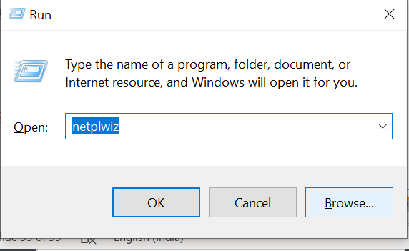
Remove Password
windows+R
Netplwiz

Slide 35
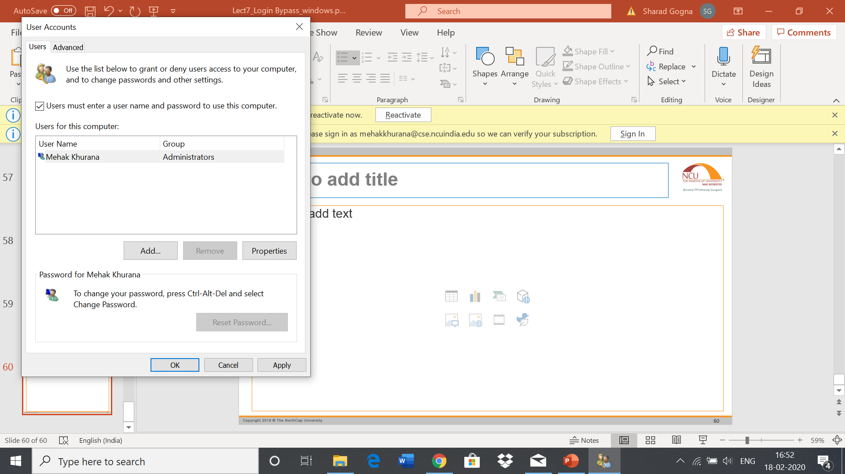
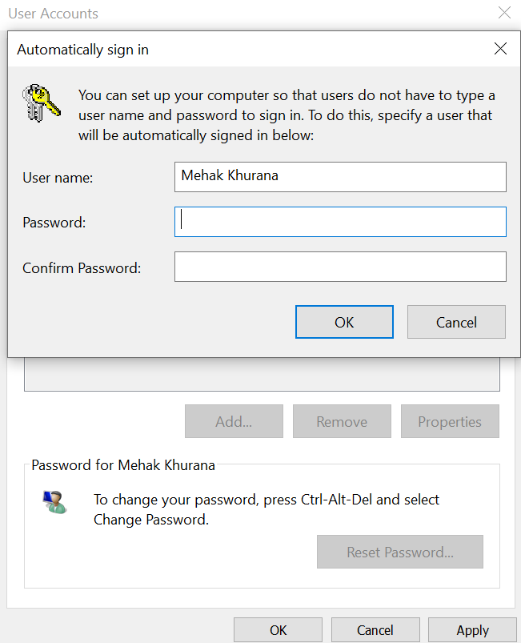
Remove password
Unselect the option
Ok
It will ask old password

